Slide 1
Attack of the Clones: Eliminating Duplicate Code in .NET
Joe Wirtley @JoeWirtley

Slide 2

About Me
Wirtley Consulting LLC
Springboro, OH
Dayton .NET Developer Group
C#, WPF, MVC, Web API
@JoeWirtley

Slide 3
Outline
Why not duplicate code?
Tools for Detection
Patterns
Identification
Solution

Slide 4
Why Duplicate Code is Bad
Increased maintenance cost
More code = more cost
Signal to noise ratio
Notes:
Clipboard inheritance, Phil

Slide 5
DRY
Don’t Repeat Yourself
Every piece of knowledge must have a single, unambiguous, authoritative representation within a system.
Tests can be “moist”

Slide 6
Detection Tools
Product | GUI | Command Line | Cost | Inexact Matches | Comments
AtomiQ | ✓ | ✓ | Free |  | Easy Highly interactive
ReSharper Duplicate Finder |  | ✓ | Free | ✓ | Comparison result is XML Baked into TeamCity Some pain to get started
Code Clone Detection | ✓ | ✓ | Free* | ✓ | Integrated in Visual Studio Can run with TFS build Slow
* Visual Studio Premium/Ultimate since 2012

Slide 7
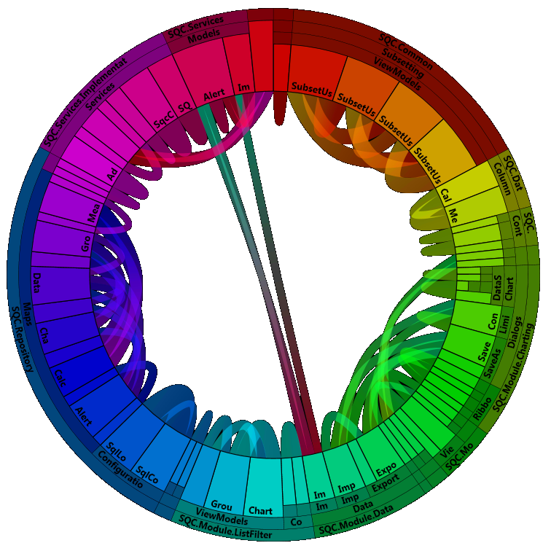
AtomiQ

Slide 8
Other Tools
ConQAT
Simian
CloneDR
Your Brain

Slide 9
Patterns
Same
Same except for location
Same except for type

Slide 10
Same
Method
Class

Slide 11
Same except for location
Related to type
Encapsulation
Method/Property
Class hierarchy
Extension method

Slide 12
Same except for location
Before/After
Delegate
Attribute
AOP

Slide 13
Same except for type
Generics
Method
Class

Slide 14
Contact Me
GitHub: https://bit.ly/EliminatingDuplicateCode
@JoeWirtley
http://WirtleyConsulting.com

